Slide 1
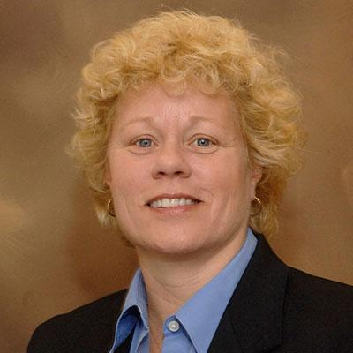
Dr. Jody L. Clasey, PhD, FACSM, FTOS
Department of Kinesiology and Health Promotion University of Kentucky
Director of the Pediatric Exercise Physiology Lab
2023 Fall Lecture
Body Composition & Health Disparities in Children: Both Hidden & In Plain View
When: Thursday, October 26th at 4:30pm
Where: The EUC, exact room TBD
Dr. Clasey will be sharing some of her research experiences including the validation of field methods for assessing body composition and discussing identified health disparities in children.
Mark this event on your calendar and be sure to lookout for more information on this free event!

Slide 2
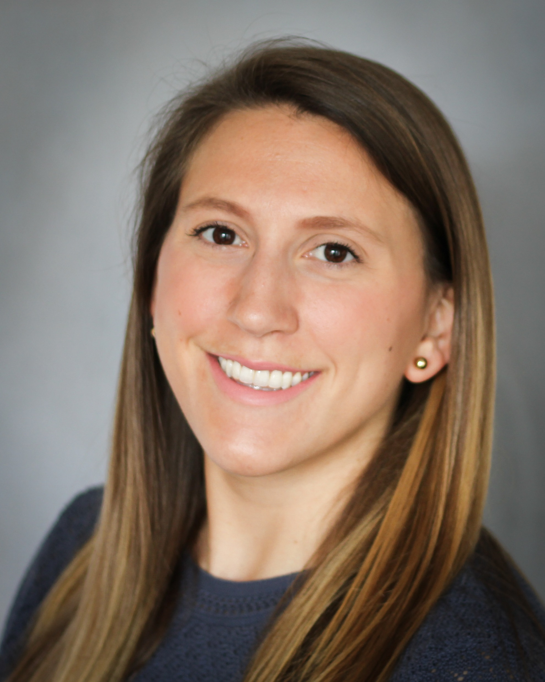
Scholarly Workshop
Communicating Your Science to the Public Through Infographics
Associate Professor in the Department of Kinesiology
Director of the Physical Activity and Lifetime Wellness Lab
Dr. Jaclyn Maher will discuss the process of developing infographics to communicate your science effectively. She will share tips, resources, and lessons learned to help you effectively convey your science to the broader, general public.
Dr. Jaclyn Maher, PhD
Friday, October 27th from 9:00am-12:00pm
The scholarly workshop is co-sponsored by the HHS Office of Research
Mark this event on your calendar and be sure to lookout for more information on this free event!

