Slide 1
Female Athlete Triad Risk Among Active Premenopausal Women
Samantha Goldenstein, M.S., CSCS

Slide 2
Female Athlete Triad
Notes:
Triad based off LEA
Healthy female
FAT-then in between
Research in elites and eating disorders

Slide 3
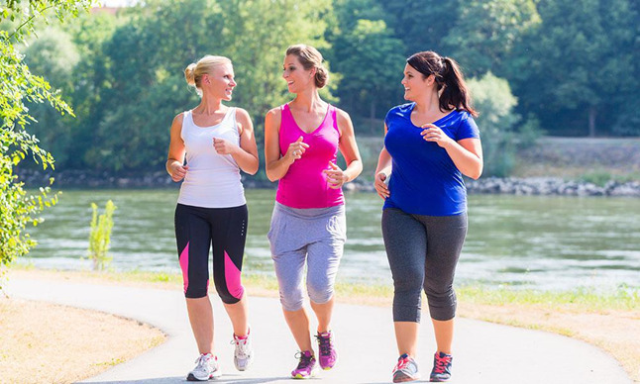
Inclusion Criteria
18-40 years old
Premenopausal
Must meet one of the following requirements:
75 min of vigorous aerobic activity
150 min of moderate aerobic activity
2 days of resistance training per week

Slide 4
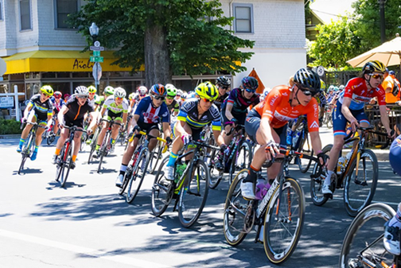
Methods
Qualtrics survey
Self-reported
Activity category (recreational or competitive)
Medical diagnosis of conditions associated with the Triad
International Physical Activity Questionnaire (IPAQ)
Physical activity for the last 7 days
Low Energy Availability Questionnaire (LEAF-Q)
Assessed injuries, gastrointestinal and menstrual function

Slide 5
Subject Demographics
 | Recreational Athlete (n=521) | Competitive Athlete (n=131)
Age (yr) | 25.01 ± 6.36* | 29.85 ± 9.33*
Height (cm) | 163.83 ± 8.76 | 166.17 ± 6.90
Weight (kg) | 67.10 ± 16.39 | 67.59 ± 13.58
BMI (kg·m²) | 25.05 ± 5.80 | 24.45 ± 4.54
Avg physical activity/week (hr) | 4.86 ± 4.09 | 5.70 ± 5.57
Data is reported as Mean ± SD
*p < .05

Slide 6
Results
44% of all participants at risk for the Female Athlete Triad
 | Recreational Athlete (n=521) | Competitive Athlete (n=131)
Risk for the Triad¹ | 230 (44.1%) | 60 (45.8%)
Total Score | 7.41 ± 4.32 | 7.81 ± 4.54
Injuries | 1.22 ± 1.90* | 1.99 ± 2.17*
Gastrointestinal Function | 2.90 ± 2.21 | 2.52 ± 2.24
Menstrual Function | 3.29 ± 2.58 | 3.30 ± 2.82
Data is reported as Mean ± SD
¹ Data reported as number (percentage); classified at risk if scored 8 or higher on the LEAF-Q
*p < .05

Slide 7
Results
24% missed 8 days or more of training/participation due to injuries
All participants started menstruation naturally
8% had their first menses at 15 yrs or older
Menstrual cycles in the last 12 months
21% 9-11 cycles
14% 8 or less
31% reported a history of their menstrual cycle stopping for 3 consecutive months or longer

Slide 8
Self-reported Medical Diagnosis
Medical Diagnosis | Total Participants (n=652) | Recreational Athlete (n=521) | Competitive Athlete (n=131)
Disordered Eating | 88 (14%) | 72 (14%) | 17 (13%)
Oligo/Amenorrhea | 39 (6%) | 19 (4%) | 10 (8%)
Stress Fracture | 74 (11%) | 46 (9%) | 28 (21%)
Low Bone Mineral Density | 11 (2%) | 6 (1%) | 5 (5%)
Data reported as number (percentage)

Slide 9
Conclusion
Physically active females are at a high risk of the Female Athlete Triad, regardless of their athlete status, total volume of physical activity, or BMI
Future Female Athlete Triad research should include recreationally active women
Development of a quick screening tool is urgently needed to identify active women at risk for the Female Athlete Triad

Slide 10
Questions?

