Slide 1
Mother Text Message Behaviors and Emerging Adult Perceived Parental Support of Autonomy
Morgan Brown¹, Michaeline Jensen¹, Andrea Hussong²
¹ University of North Carolina Greensboro, Psychology
² University of North Carolina Chapel Hill, Psychology and Neuroscience
Notes:
Hello everyone I am sorry I could not make it today, but glad to have the opportunity to record my presentation and still get to share some work that I hope you find just as excting as I do

Slide 2
Emerging Adulthood
Emerging Adulthood; encompasses ages 18-25
Developmental tasks of increasing independence and self-reliance (Soenens et al., 2007)
Arnett’s Theory of Emerging Adulthood
Notes:
Emerging Adulthood; encompasses ages 18-25 and is characterized by new transitions experiences and developmental tasks of increasing independence and self-reliance (Soenens et al., 2007)
Youth are striving to balance increasing independence and emotional connection with parents
Arnett’s (2000) posits that gaining autonomy from parents and making independent life choices is necessary for not only the health of emerging adults but also a healthy transition into adulthood

Slide 3
What does Mother Support for Autonomy look like in Emerging Adulthood and why is it important?
Autonomy is among 3 universal psychological needs (Deci & Ryan, 2000)
Emerging adults who tend to be more autonomous endorse better psychosocial adjustment (Lekes et al. 2010; Cullaty, 2011)
Notes:
Autonomy is the extent to which individuals fully endorse the behaviors in which they engage and so a really important theory in understanding is the self-determination theory
Self-determination theory posits that autonomy is among 3 universal psychological human needs alongisde relatedness and competence and parents play a role in facilitating the fulfillment of their emerging adult’s needs,
3. Important because emerging adults who tend to be more autonomous endorse better psychosocial adjustment (Lekes et al. 2010; Cullaty, 2011)
4. Including higher self-esteem, self-efficacy and lower levels of depression

Slide 4
What do Mothers do to Support Youth Autonomy?
Engagement? Responsiveness? Monitoring?
Helicopter parenting?
Best in moderation?
Notes:
We know from decades of research that parents are one of the most powerful influences for children and adolescents social, psychological, and behavioral well-being (Collins et al., 2000)
Less however is known about emerging adulthood, but we can use how parents behave in childhood and adolescence to give us clues on how they might behave in emerging adulthood
The 3 areas I am interested in here that overlaps with the parenting literature are llevels of engagement, responsiveness, and monitoring
The literature however on how much of these behaviors are good for emerging adult autonomy development is mixed;
past literature has suggested that more is better for responsiveness that developmentally appropriate levels of monitoring are good,
6. Here hoever I am hypothesizing that for emerging adults moderate may be best as we consider their developmental tasks `

Slide 5
Digital Communication in Mother-Emerging Adult Dyads
Digital communication offers us a window into naturalistic parent-emerging adult interactions
Co-construction theory
Digital communication is important for emerging adult-parent dyads as this is a period where children are living away from home for the first time
Notes:
When we are thinking of parenting of young adults we have to think of how and where these dyads are interacting , these interactions are happening more and more online
Digital communication offers us a window into naturalistic parent-emerging adult interactions
So while we can't carry around a camera and video tape parent and child interactions all day , text messages allow us to see how in the moment parenting occurs
Co-construction theory is helpful in asserting that online and offline behaviors often mirror and impact each other (Subrahmanyam et al., 2006)
This can be exemplified through parents who engaged in more online mointirong also engaged in higher levels of face-face moinotring
parent-emerging adult digital communcation is also benefical in helping emerging adults to maintian the important emotional connection with their parents as this is a period where they are first moving away from home; this is especially salient with this sample as they are college students living in dorms

Slide 6
Current Study
Do mothers affect their emerging adult children’s perception of autonomy support?
Is mother texting frequency tied to emerging adult perceptions of mother autonomy support? (is this association best characterized as LINEAR or QUADRATIC?)
Is mother digital responsiveness tied to emerging adult perceptions of mother autonomy support? (is this association best characterized as LINEAR or QUADRATIC?)
Is mother digital monitoring tied to emerging adult perceptions of mother autonomy support? (is this association best characterized as LINEAR or QUADRATIC?)
Notes:
So here are the overarching and the three sub questions
With the thought that the quadratic association is to model that these behaviors will be best in moderation

Slide 7
Sample and Measures
Sample Characteristics
Total Sample |  |  | 267
Average Age |  |  | 19.85
Sex
 | Male | Male | 45.96%
 | Female | Female | 54.04%
Race/Ethnicity
 | Black | Black | 22.12%
 | Asian | Asian | 11.18%
 | Hispanic- Any Race | Hispanic- Any Race | 5.40%
 | White | White | 59.76%
Year in Undergraduate Degree
 | 1st year Undergraduate | 1st year Undergraduate | 28.69%
 | Sophomore | Sophomore | 20.61%
 | Junior | Junior | 20.02%
 | Senior | Senior | 29.04%
Sample
267 College students at elite Southeastern University
Consented and contributed 560,172 text messages exchanged with all conversation partners over 2-weeks
To be included in the present study participants had to send at least one text message to their parent(s) (N=238)
Measures
Demographic Covariates (age, sex, parental education status as a proxy for SES)
Parental Support of Autonomy
(Steinberg et al., 1989; 1991, 1992)
Example Item: How often did your mother tell you that her ideas were correct and that you should not question them? ​
Notes:
This study is a secondary data analysis
Data collected between 2014- 2015; at a prestigious Southeatern University
Collected demographic covariest and Steinberg’s parental support of autonomy
Here I have provided an example item and also provided the some characteristics of the present sample

Slide 8
Parent-Child Text Interaction Coding Scheme
30,000 parent-emerging adult text messages qualitatively coded by 2 coders (20% double coded for reliability)
Codes assigned per text message; not mutually exclusive or exhaustive
Jensen, Hussong, & Haston (2021)
N = 215 (Mother) |  |  | IRR (Κ)
Digital Responsiveness
 | Parent Emotional/Esteem Support Provision | Discusses provision of emotional support or esteem support. Occurs in the context of a need or social support seeking. | .66
 | Parent Tangible Aid Provision | Discusses provision of tangible aid. May include favors, gifts, money. Occurs in the context of a need or instrumental support seeking. | .55
 | Parent Advice Provision | Demonstrates provision of advice or guidance. Usually solicited, non-directive, or teaching. | .61
 | Parent Warmth | Expressions of care, concern, support, or encouragement. Facilitates a positive connection. May include endearment, expressions of affection and love, warm greetings, and compliments. | .85
Digital Monitoring
 | Emerging Adult Disclosure | Discloses information about his/her behavior, wellbeing, activities, relationships, whereabouts. | .73
 | Parent Solicitation | Asks questions about behavior, wellbeing, activities, relationships, whereabouts | .82
 | Parent Control | Reminders of expectations and rules for behavior. Usually directive, actionable, and/or unsolicited. | .69
Notes:
So here I am providing you with the scheme we used to code the 30,000 of the total 500,000 text messages that student exchanged with thier parents
So to capture digital respoinsivness we used XXX and then to camputre moinitoring we used XXXX and I have also included the interrater reliability of all codes

Slide 9
Are mother texting behaviors tied to emerging adult perceptions of parental autonomy support?
Models were run separately for mother-emerging adult
First, Perceived Parental Support of Autonomy was regressed (in separate models, alongside covariates) on
1. Mother-EA texting frequency
2. Mother digital responsiveness codes
3. Mother monitoring codes
Next, we added quadratic terms to the first (linear) models
Notes:
First, Perceived Parental Support of Autonomy was regressed on mother-EA texting frequency and covariates of gender, age, and parent education to test our linear hypothesis
To test our quadratic hypothesis or that moderate levels may be best we dded the quadratic term
We then regressed Perceived Parental Support of Autonomy on the covariates, and digital responsivness (in separate models so resulring in 4 total models)
We also tested our quadtatic hypothesise y adding the quadtatic term
We conduct the same method for moinitoring behaviors using separate models so resulting in 3
Finally testing quadtatic effect

Slide 10
Results

Slide 11
Results
 | ​ | Emerging Adult Perceived Mother Support of Autonomy (N = 215) ​
 | ​ | b ​ | SE ​ | p ​
1. Parent-EA Texting Frequency
 | Parent Texting Frequency Linear ​ Parent Texting Frequency Quadratic ​ | -.025 -.013 | .128 .016 | .843 .416
2. Digital Responsiveness
 | Parent Advice Provision Linear ​ Parent Advice Provision Quadratic ​ | -.017 -.001 ​ | .032 ​ .001 ​ | .589 .119
 | Parent Instrumental Support Linear ​ Parent Instrumental Support Quadratic ​ | -.008 -.001​ | .039 .002​ | .844 .696
 | Parental Emotional/Esteem Support Provision Linear ​ Parent Emotional/Esteem Support Provision Quadratic ​ | -.007 -.001​ | .037 .001​ | .850 .135​
 | Parent Warmth Linear ​ Parent Warmth Quadratic ​ | -.001​ -000​ | .023 .0​00 | .949 .483
3. Digital Monitoring
 | Parental Control Linear ​ Parental Control Quadratic ​ | -.047​ .001​ | .033​ .001​ | .156​ .541​
 | Parental Solicitation Linear ​ Parental Solicitation Quadratic​ | -.009 .000​ | .013 .000​ | .487​ .746
 | Youth Disclosure Linear Youth Disclosure Quadratic ​ | .076 -.813 | .049 .260 | .121 .002
Note. Each model contained a single digital code alongside covariates (gender, parental education, as a proxy for SES, and age). Associations p≤.05 bolded.
Notes:
Here we can see the only significant association was the quadratic affect of youth disclosure

Slide 12
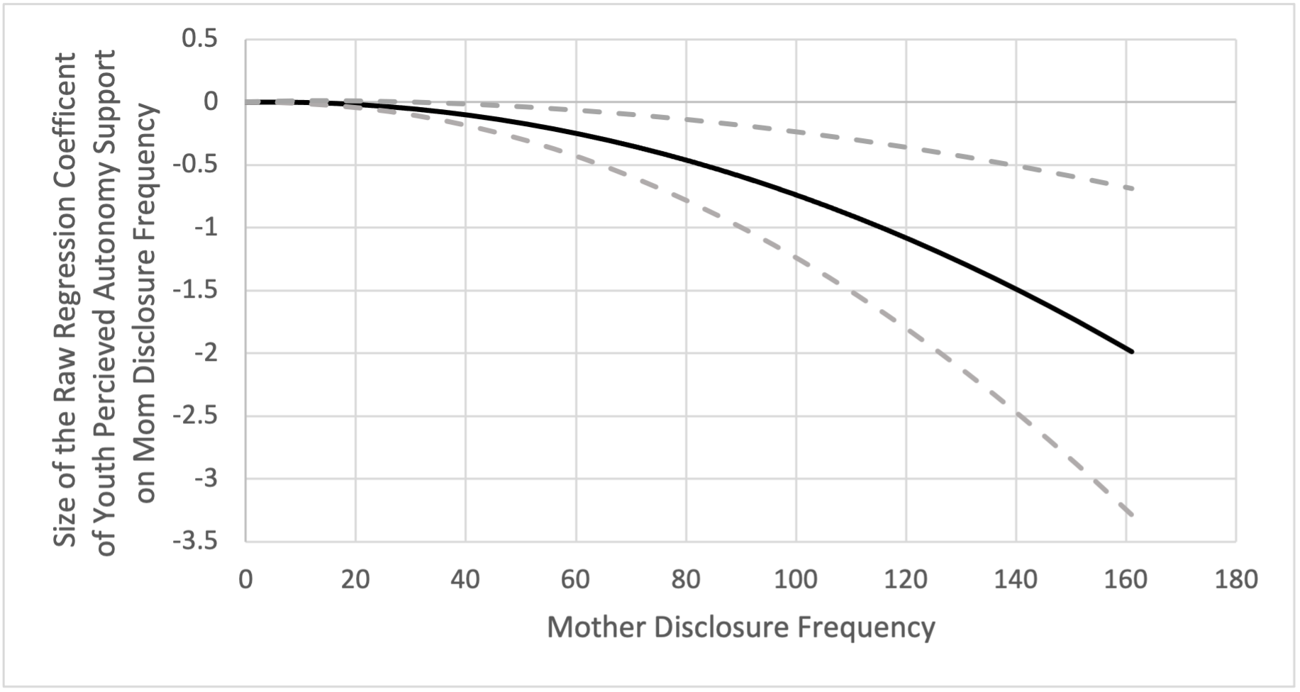
95%
99%
Notes:
So here we have mom disclosure frequency plotted alongside the raw regression coefficient of autonomy support on mom disclosure and the included demographic covariates; this was done in order to have the ability to see the whole range of data
The grey dashed lines represent the 95% confidence intervals
So essentially what this graph is telling is at high levels of mother disclosure frequency emerging adults perceive their parents as less supportive of their autonomy

Slide 13
Discussion
Findings indicate (limited) support for the potential detrimental effects of overparenting
However, it is important to note that most dyads are not demonstrating these behaviors
Notes:
As high levels of disclosure was negatively association with autonomy support
And not only most dyads but most behaviors were not associated with perceived autonomy support

Slide 14
Limitations
Cross-sectional Data – impossible to determine the direction of effects
Interrater Reliability of PC-TICS – although many codes demonstrated strong interrater reliability, such as parental warmth (κ > .85) other codes, like tangible aid (κ > .55) were lower and in the moderate range.
Power and Sample Size Limitations - inhibit our ability to test for potential subgroup (especially racial/ethnic) differences that are likely relevant in the study of digital parenting and autonomy support
Operationalization of Autonomy Support – measure is not consistent with current findings of the autonomy support being multi-dimensional (promotion of independence and promotion of volitional functioning)

Slide 15
Questions
Feel free to email me at mtbrown4@uncg.edu with any questions

