Slide 1
The influence of menstrual cycle phase on fluid intake and urinary hydration markers
Mitchell Zaplatosch, MS, RD, LDN

Slide 2
background
Variation in the major female sex hormones (estrogen and progesterone) influence fluid balance:
Contribute to shifts in intra- and extracellular fluid
Altered set point threshold for the release of the fluid regulatory hormone arginine vasopressin^{1,2}.
Specifically, ↑ hormone concentrations during the luteal phase may ↓ plasma volume and ↑ osmolality, in addition to ↑ interstitial fluid (i.e., edema).
However, it is unclear if and how these shifts in fluid balance influence fluid intake behaviors across the menstrual cycle.
Oral contraceptives differ in their mechanisms of action and contain hormone concentrations which could further reduce the osmotic threshold for vasopressin and thirst stimulation³. Therefore, we chose to look first at naturally cycling females.

Slide 3
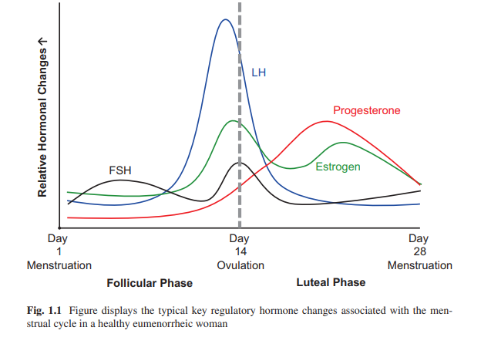
Notes:
EF: Lower progesterone
LF: Higher estrogen, progesterone increases.
ML: Higher progesterone, lower estrogen
Figure from: Hackney, Anthony. (2016). Sex Hormones, Exercise & Women. 10.1007/978-3-319-44558-8.

Slide 4
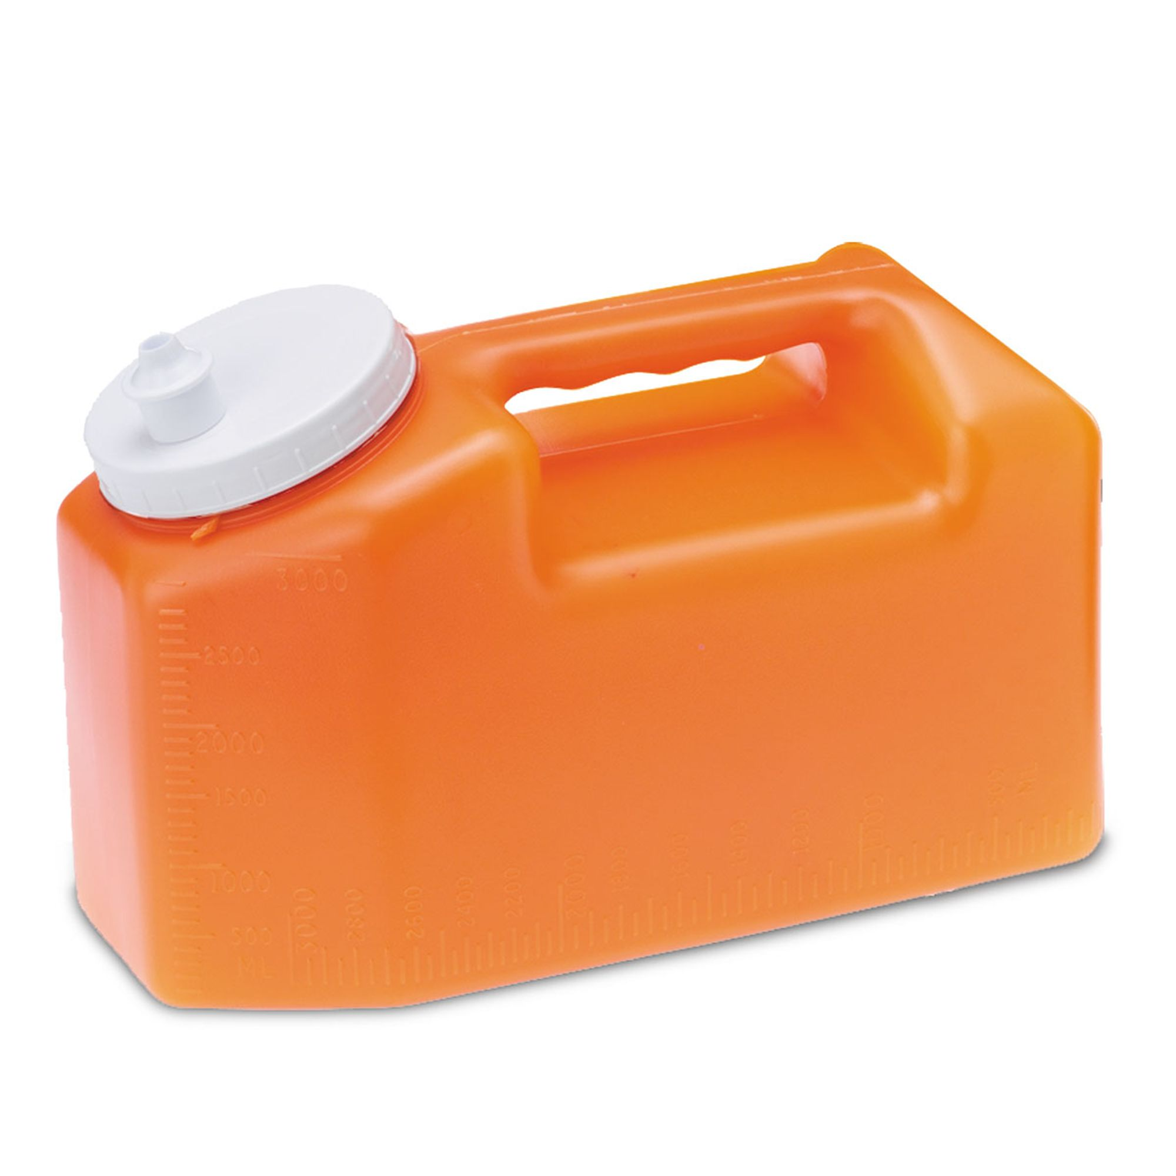
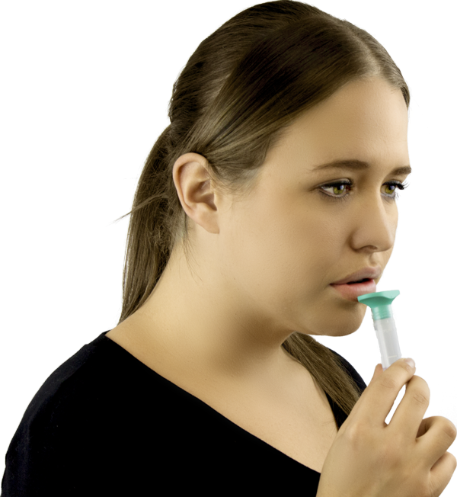
Design
Early Follicular (EF: Days 3-5)
Late Follicular (LF: Days 11-13)
Mid Luteal (ML: Days 18-20
Lab Measures
Home Measures
17 Females (Mean±SD; age, 24±5 y; height, 163±7 cm; mass, 71.3±24.4 kg; body fat, 22.7±9.3%)
Not taking oral contraceptives
Nude Body Mass
Copeptin
Estrogen
Progesterone
Stroop
MST
Thirst
Mood
Cortisone
Cortisol
Dietary Record
•Water/Fluid
Urine specific gravity
Urine osmolality
Urine color
Urine volume
Notes:
We also assessed physical activity across the entire month via Actiwatch.

Slide 5
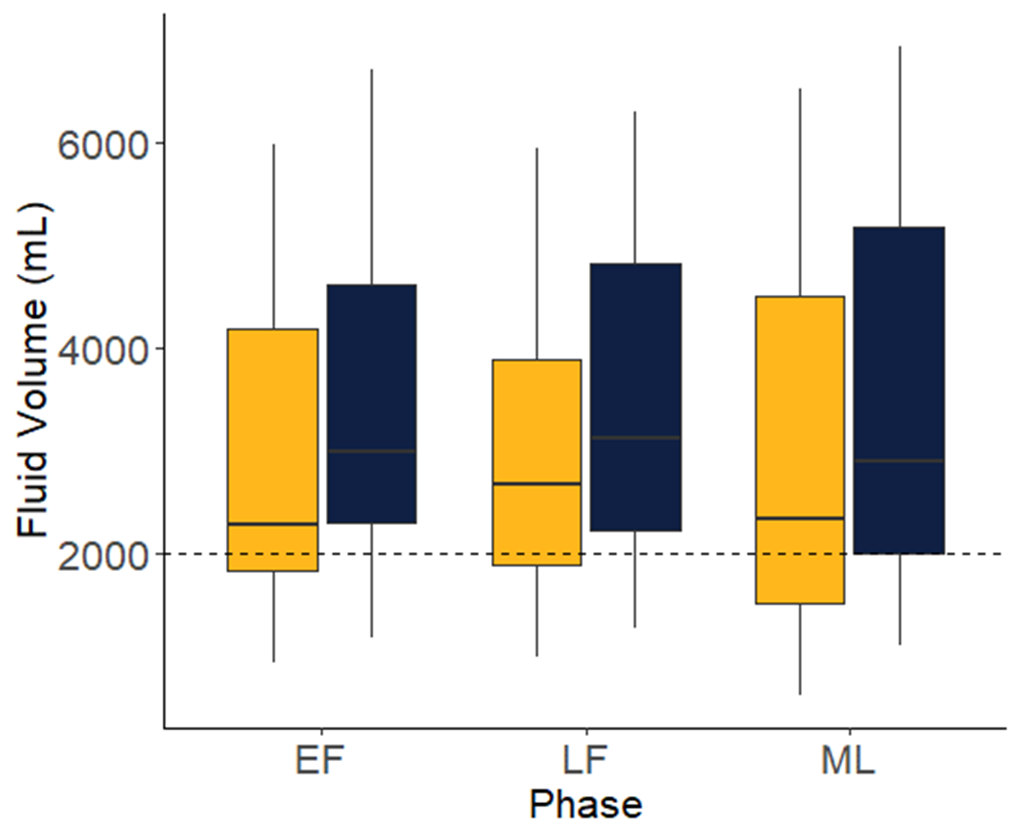
Results – Fluid intake
Notes:
On average, participants tended to meet fluid intake recommendations. Yellow bar represents intake from water, whereas blue represents intake from water and food moisture.
No difference in intake throughout the menstrual cycle.

Slide 6
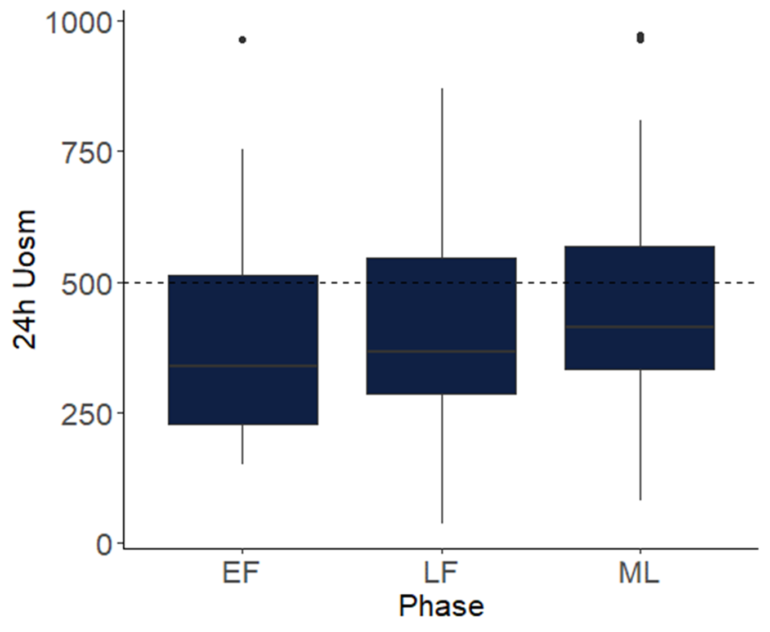
Results – urinary hydration biomarkers
Notes:
U_{OSM} was significantly greater during MC_{ML} (465±217 mOsm∙kg⁻¹) than MC_{EF} (393±193 mOsm∙kg⁻¹) or MC_{LF} (426±203 mOsm∙kg⁻¹)

Slide 7
Notes:
U_{VOL} was significantly greater during MC_{EF} (2.36±1.33 L) compared to MC_{LF} (2.09±1.41 L) and MC_{ML} (2.20±1.40 L). Suggesting more fluid retention in the interstitial space (edema) during the later phases.

Slide 8
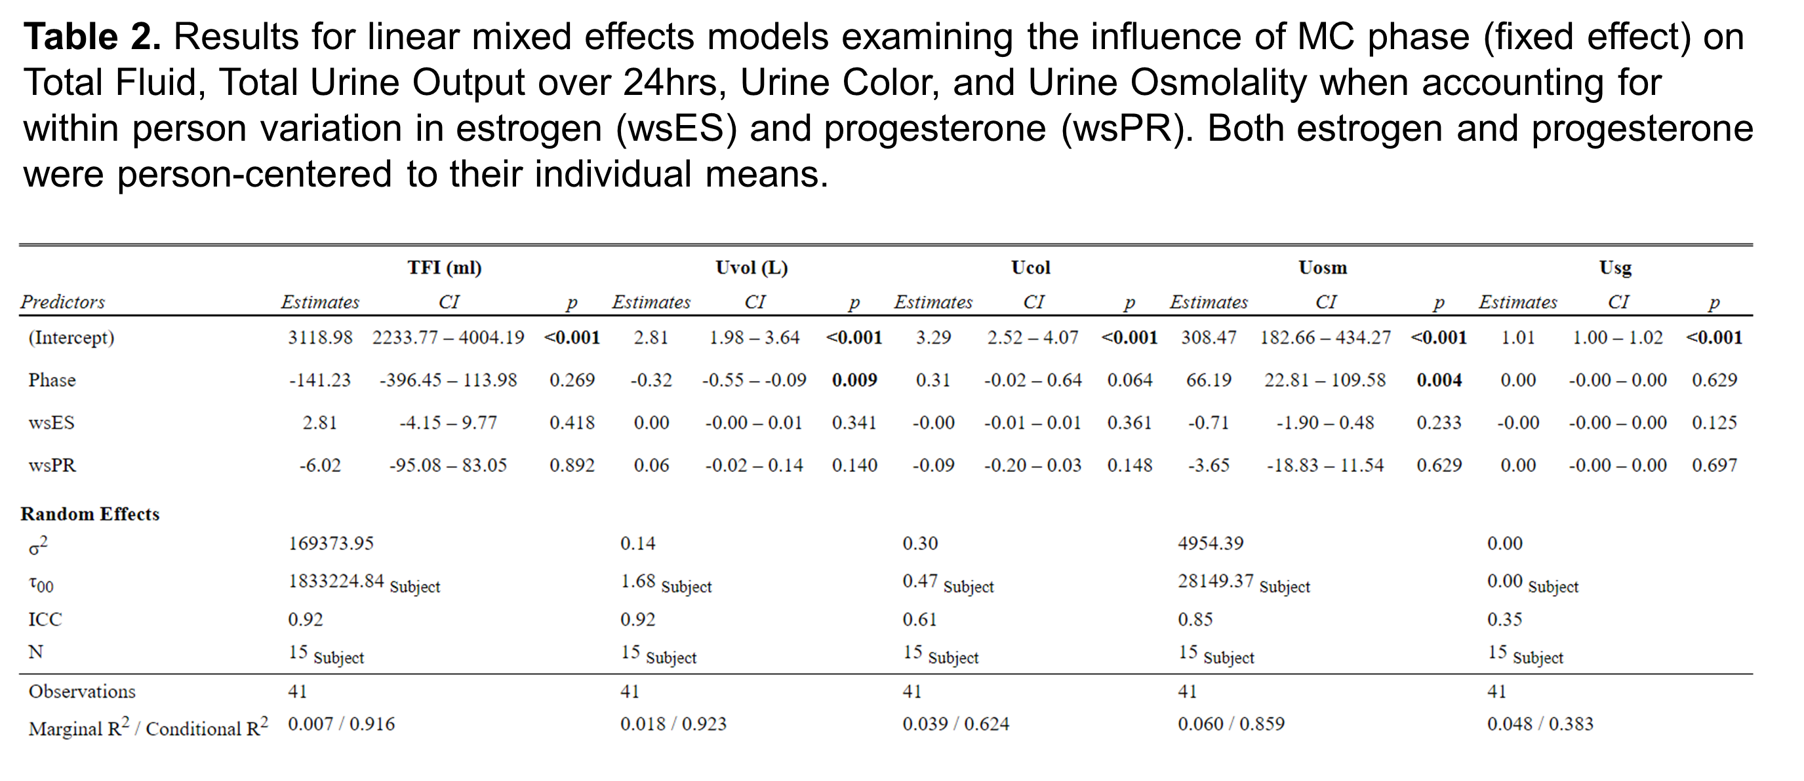
Notes:
Effects were similar when accounting for within-subject variations in estrogen and progesterone levels.

Slide 9
conclusions
Fluid intake behaviors in naturally cycling females do not change across the menstrual cycle despite differences in 24h urine volume and 24h urine osmolality.
Other hormonal factors (i.e., changes in vasopressin/copeptin and/or aldosterone) may have influenced urinary hydration biomarkers.
Our sample met current fluid recommendations, so future research should examine if these effects hold true in those habitually consuming below recommended intake levels.
This requires further study in females on oral contraceptives.

Slide 10
Thanks!
Dr. William Adams
Dr. Laurie Wideman
Emily Bechke
Samantha Goldenstein
Madelyn Biffle

Slide 11
references
Giersch GEW, Charkoudian N, Stearns RL et al. Sports Medicine. 2020;50:253-261.
Vokes TJ, Weiss NM, Schreiber J et al. Am J Physiol. 1988;254(4Pt 2):R641-7.
Stachenfeld NS. Exerc Sport Sci Rev. 2008;36(3):152-9.
EFSA Panel on Dietetic Products, Nutrition, and Allergies (NDA). EFSA Journal. 2010;8(3):1459.
Johnson EC, Peronnet F, Jansen LT et al. J Nutr. 2017 Oct;147(10):2001-2007.

